Slide 1
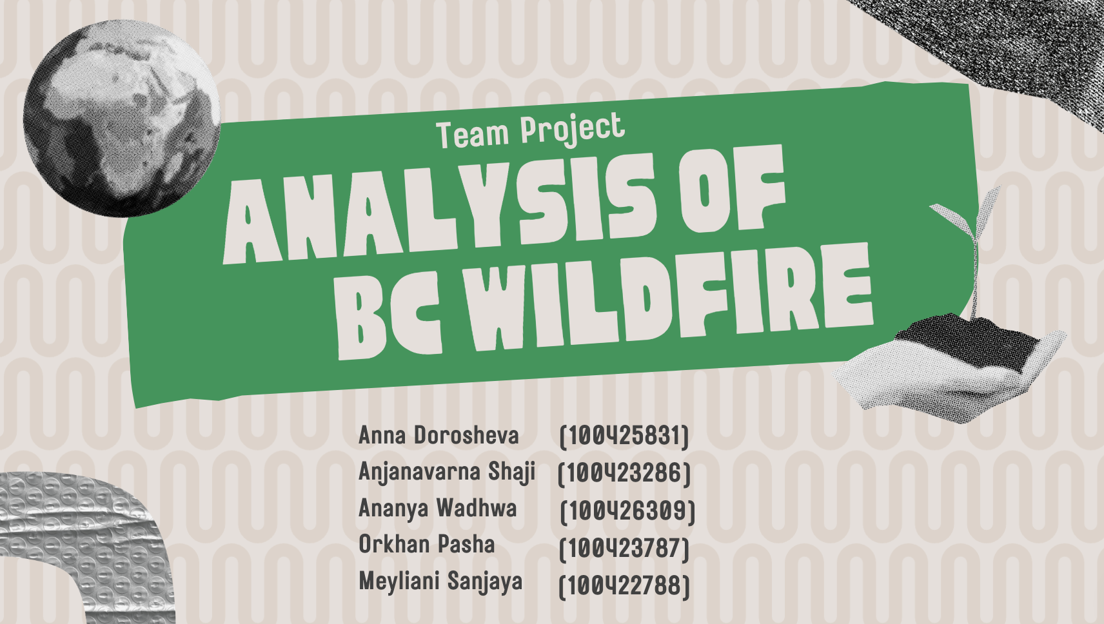
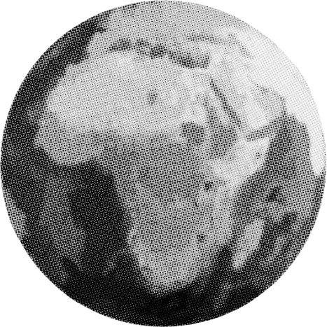

Team Project
analysis of
BC WILDFIRE

Slide 2
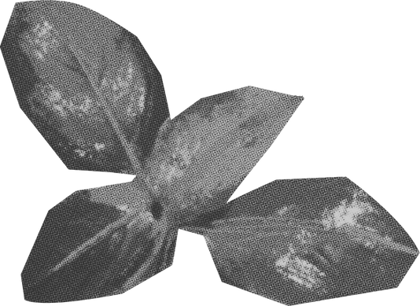
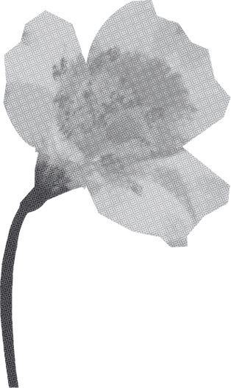
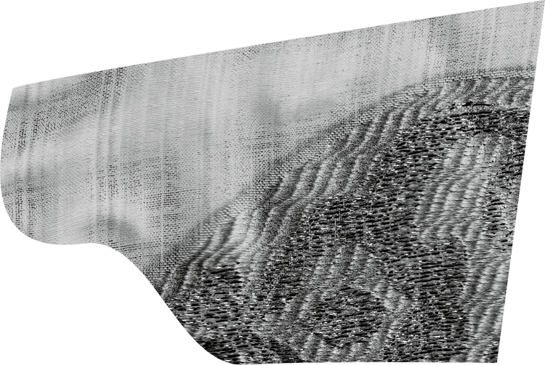
AGENDA
1
EDA PROCESS
2
CLUSTERING FIRE EVENT
3
EXPLORATION OF VARIABLES
4
TREND ANALYSIS
5
T-TEST AND MODEL

Slide 3

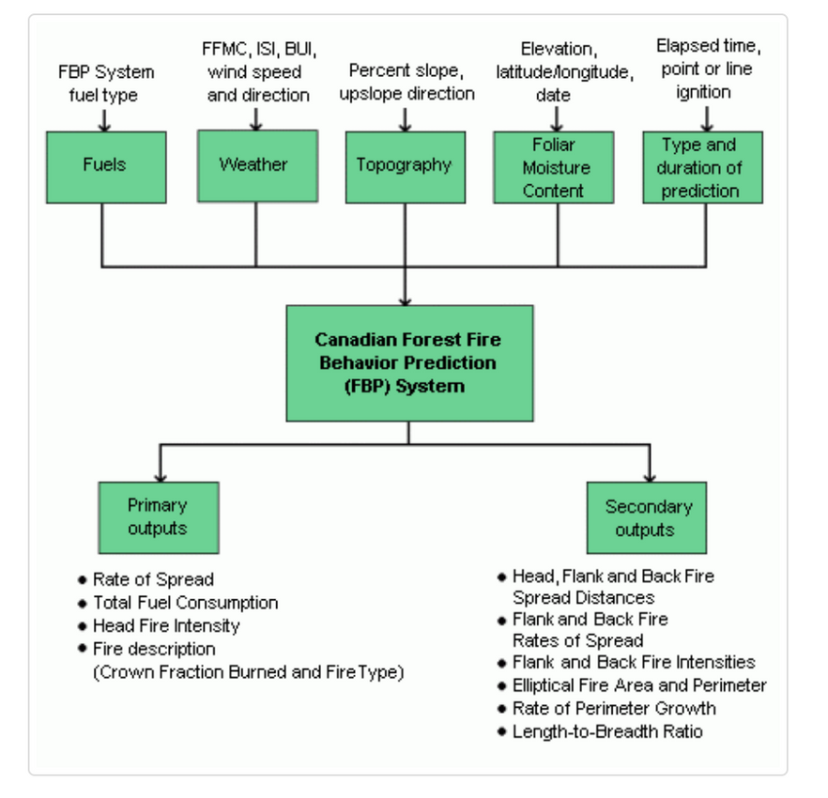
SCOPE OF ANALYSIS
HOTSPOT AND WEATHER DATA FROM 2014 - 2023
FIRE INDEX VARIABLES USE ON CANADIAN
FOREST FIRE BEHAVIOR PREDICTION SYSTEM

Slide 4
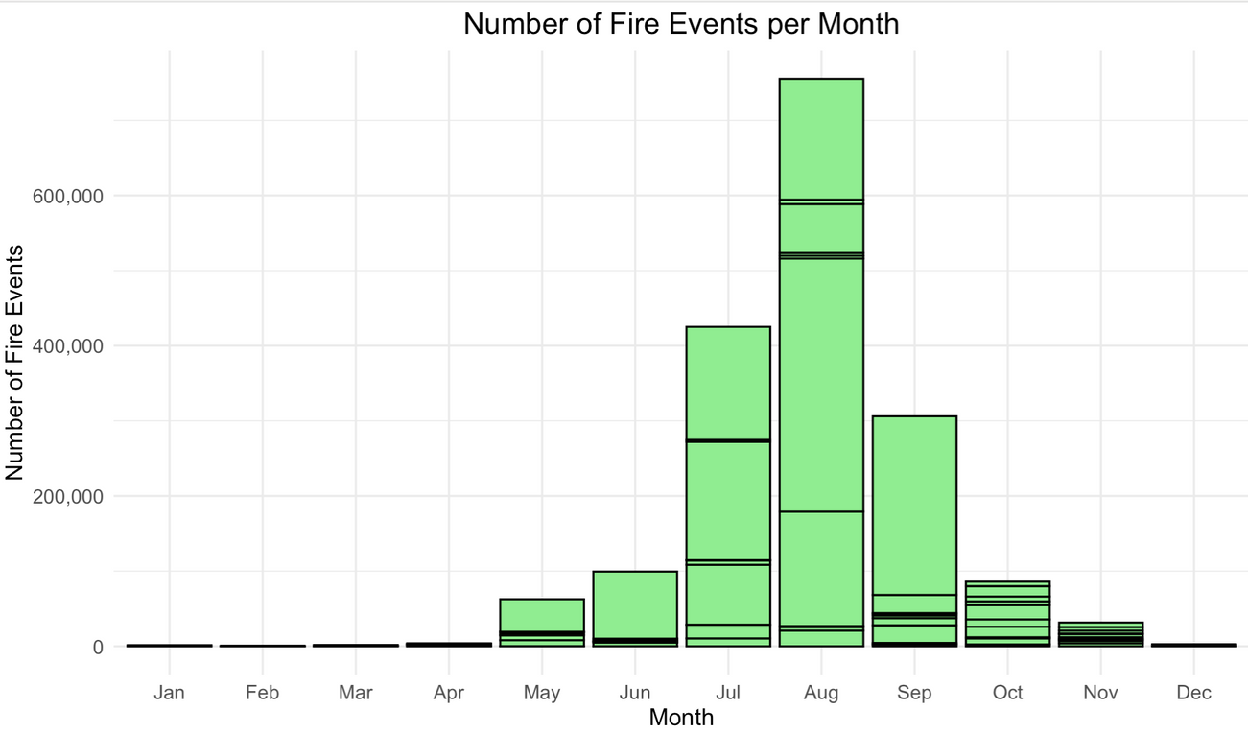
SCOPE OF ANALYSIS
DATA CONCENTRATION FROM MAY - OCTOBER OR “PEAK”

Slide 5
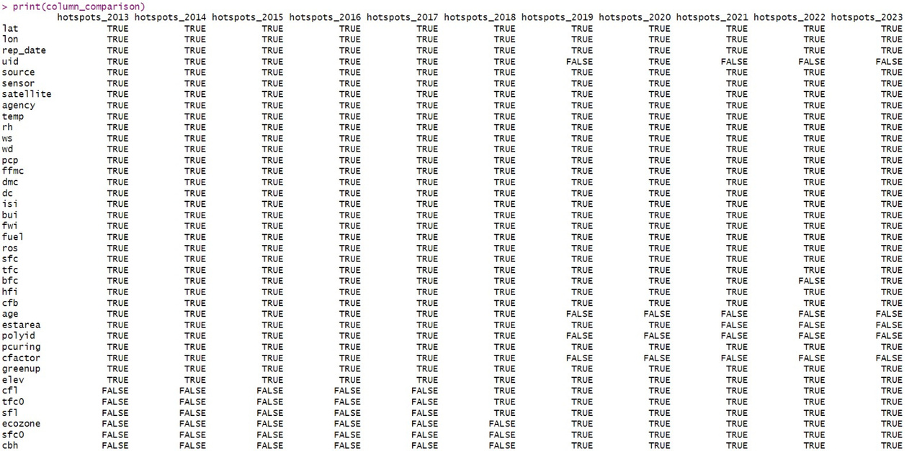
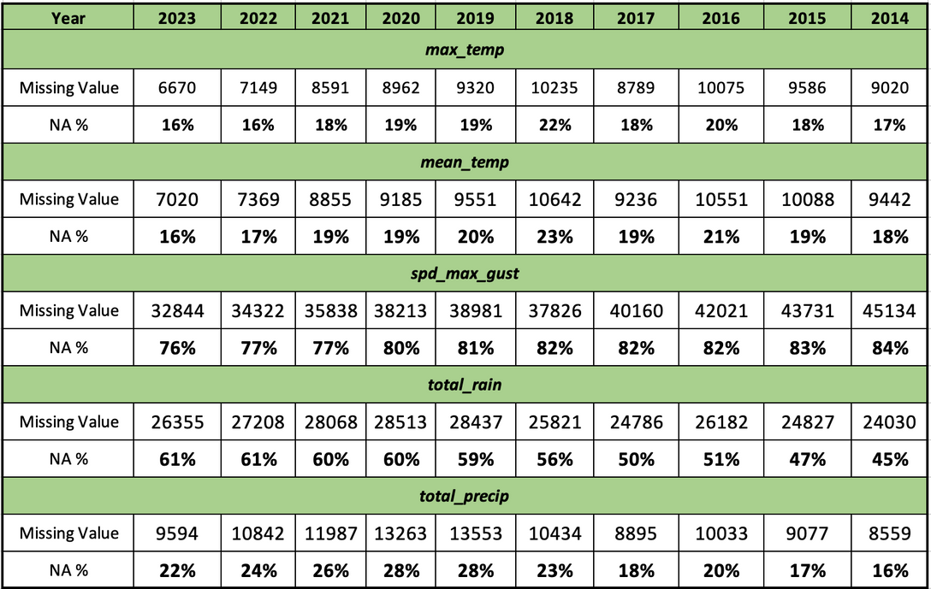
e
d
a
HOTSPOT
DIMENSION :
1781.266 ROWS
41 VARIABLES
Variable | % Missing Value
cool_deg_days_flag | 97%
dir_max_gust_flag | 93%
heat_deg_days_flag | 97%
max_temp_flag | 97%
mean_temp_flag | 97%
min_temp_flag | 97%
snow_grnd_flag | 97%
spd_max_gust_glag | 93%
total_precip_flag | 89%
total_rain_flag | 81%
total_snow_flag | 82%
WEATHER
DIMENSION :
1000.928 ROWS
38 VARIABLES
Variable | % Missing Value
heat_deg_days | 18%
dir_max_gust | 80%
max_temp | 17%
mean_temp | 18%
min_temp | 17%
snow_grnd | 52%
spd_max_gust | 80%

Slide 6
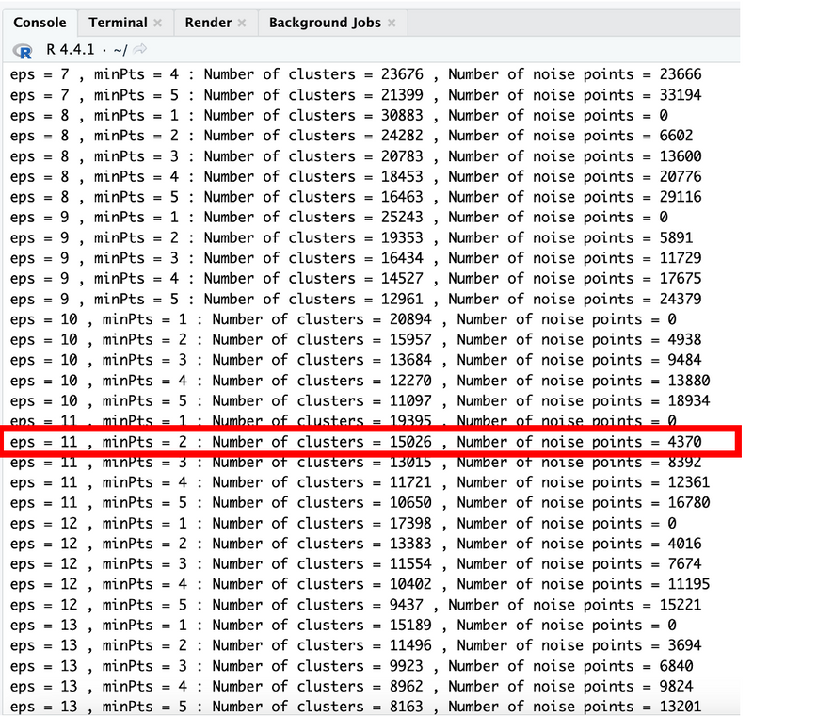
CLUSTERING FIRE EVENTS
APPLY DBSCAN (DENSITY-BASED SPATIAL CLUSTERING AND APPLICATION WITH NOISE)
AND VISUALIZE IT ON MAP
Using Iteration to find suitable radius and clustered into 15.026 fire events with 4370 noise, which is the closest to the BC official records of fire for 10 years (15.095)*
*https://www2.gov.bc.ca/gov/content/safety/wildfire-status/about-bcws/wildfire-statistics/wildfire-averages

Slide 7
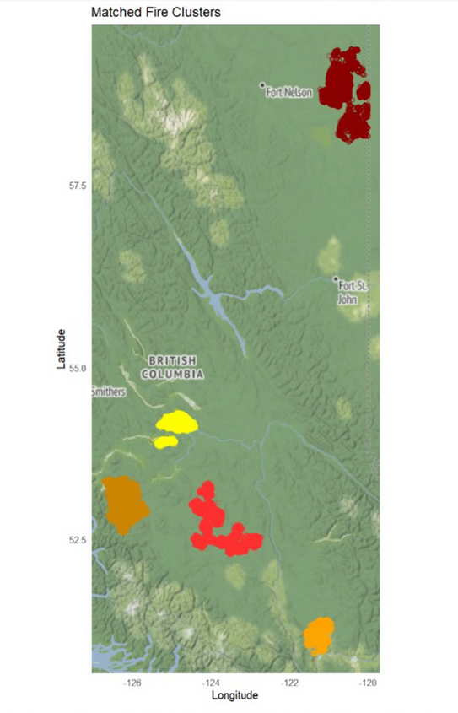

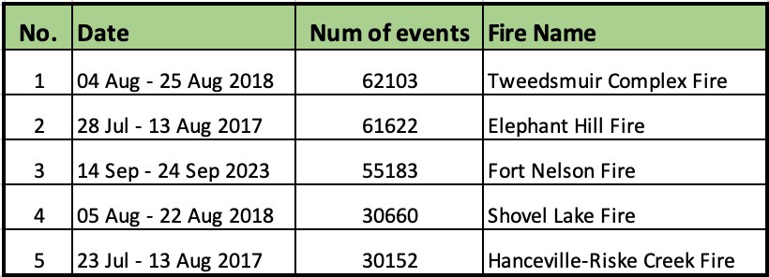
CLUSTERING FIRE EVENTS
TOP 5 CLUSTER BY NUMBER OF EVENT
3
4
1
5
2

Slide 8
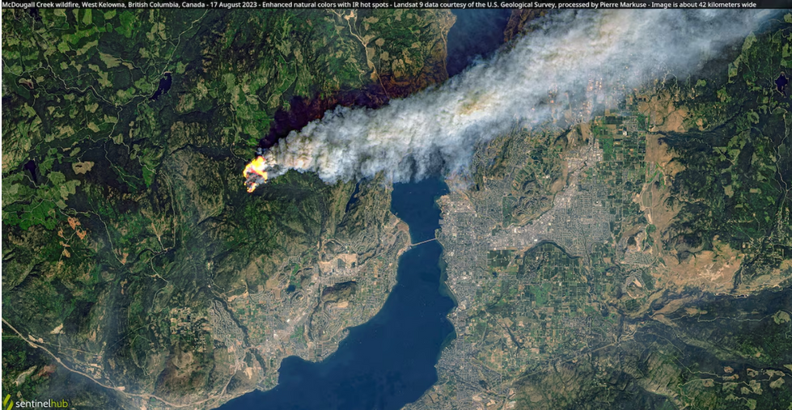
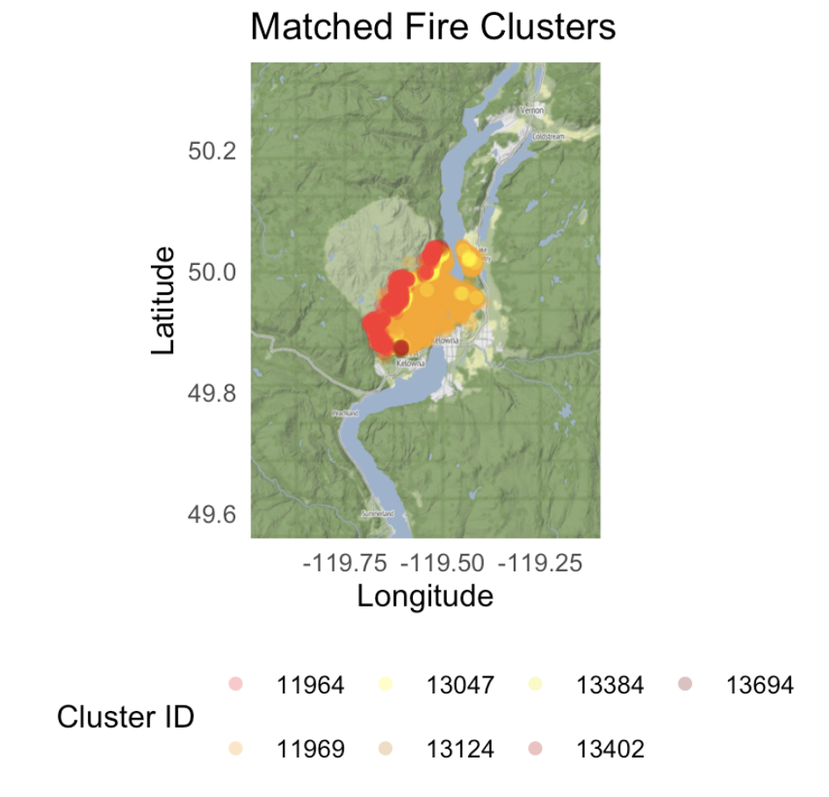
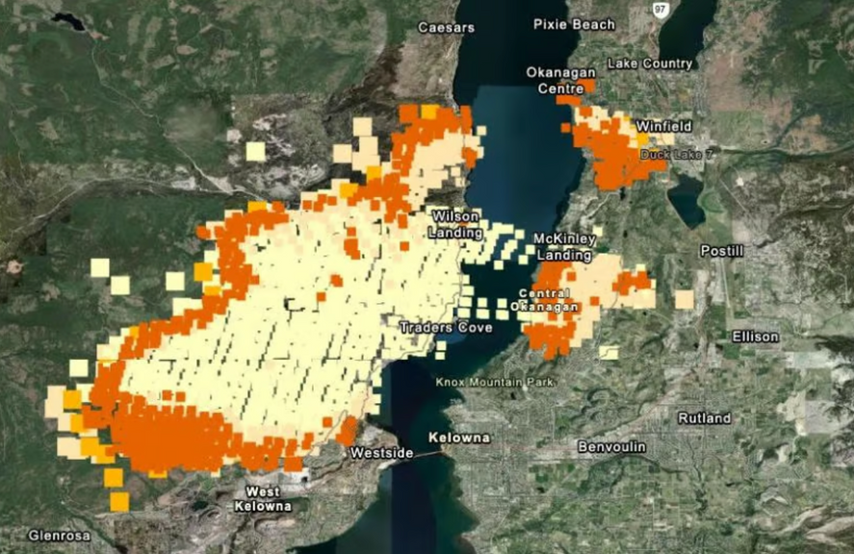
unique fire event
KELOWNA FIRE IN 2023 or MCDOUGALL CREEK FIRE
Satellite image
Thermal imaging photo from NASA

Slide 9
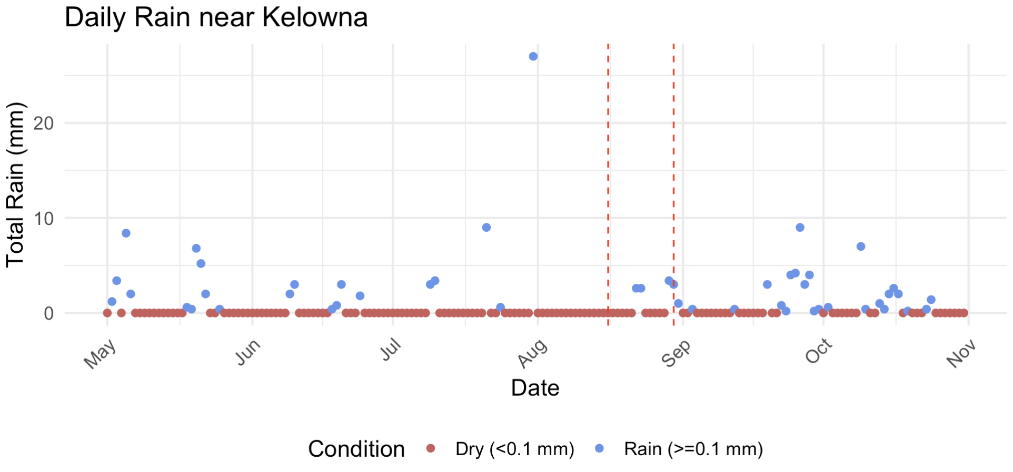
unique fire event
WEATHER RECORDS FROM KELOWNA’S FIRE STATION
Weather station within 25km of Kelowna
OKANAGAN CENTRE
PEACHLAND
WINFIELD
KELOWNA MWSO
KELOWNA UBCO

Slide 10

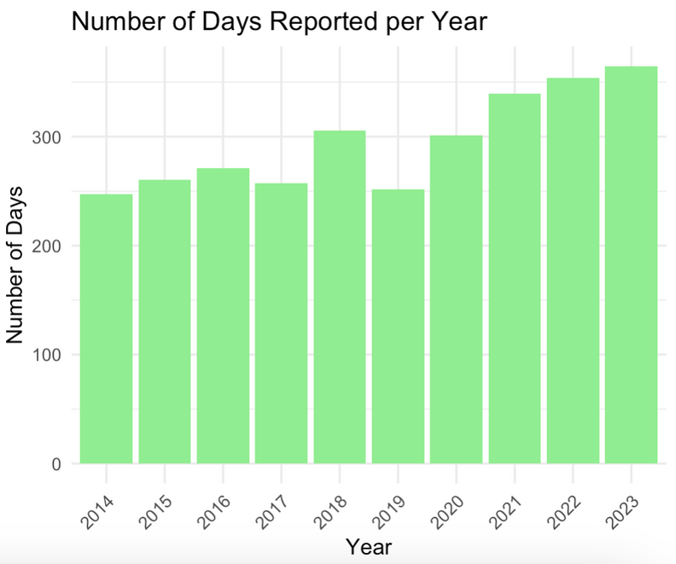
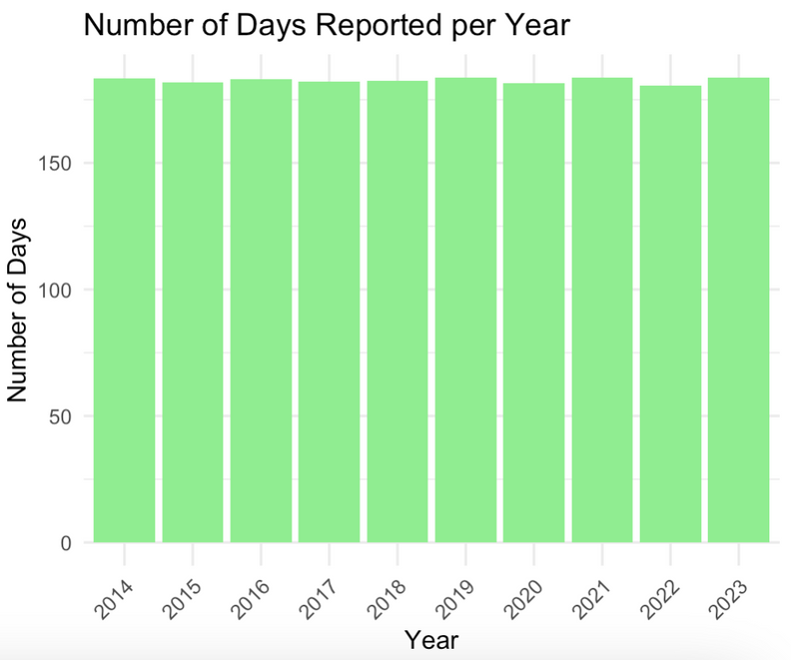
From fire dataset it shows the number of days reported every year.
Data collection shows improvement in the recent years.
*raw hotspot dataset
*peak hotspot dataset

Slide 11
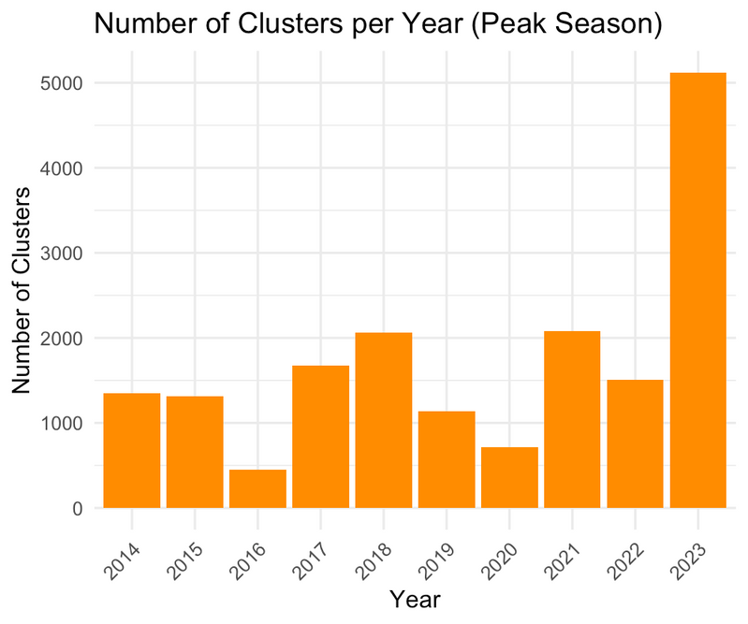
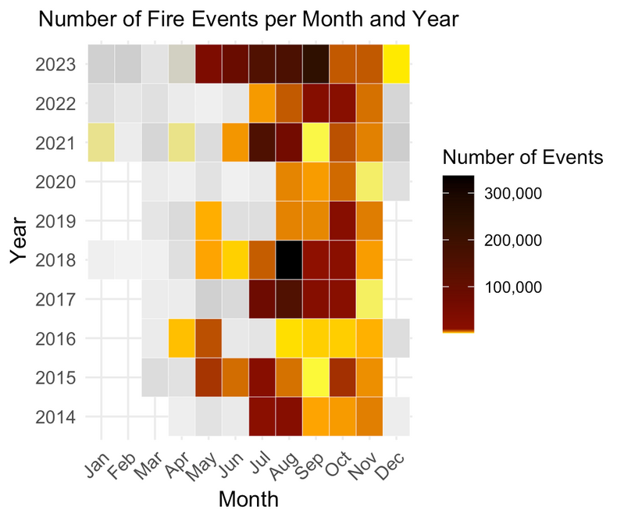
Number of cluster per year
in the peak season
and the background of decision to concentrate
during period of May - Oct

Slide 12
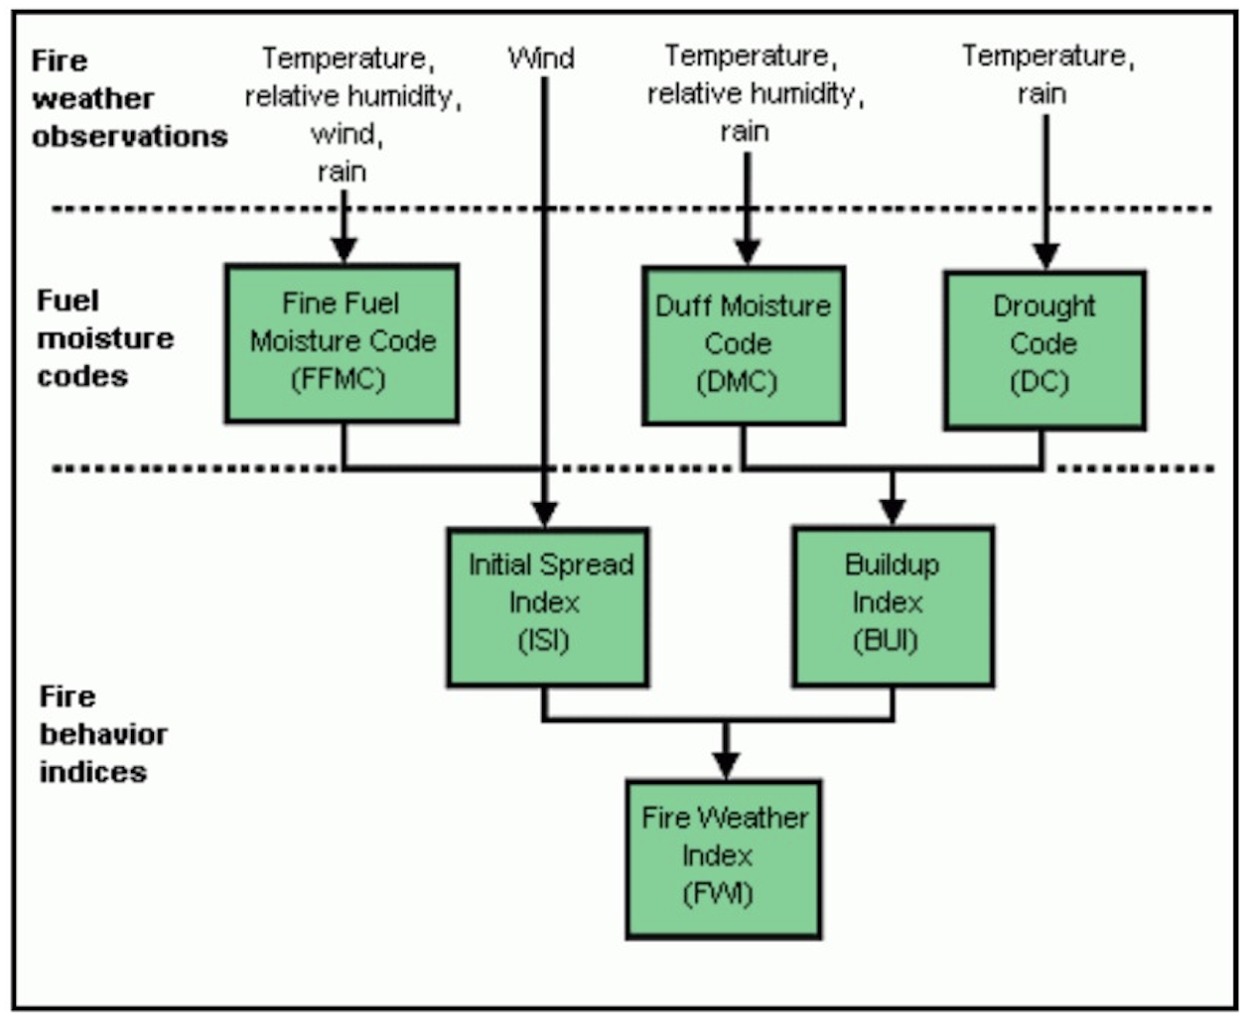
SUMMARY OF VARIABLES
Variable | Missing Value | Min | Median | Mean | Max
FFMC | 0 | 0.3 | 91.50 | 89.53 | 99.00
DMC | 0 | 0.0 | 85.20 | 92.60 | 459.78
DC | 0 | 0.0 | 531.77 | 518.81 | 1122.11
ISI | 0 | 0.0 | 8.62 | 8.50 | 137.70
BUI | 0 | 0.0 | 119.12 | 123.42 | 458.66
FWI | 0 | 0.0 | 30.09 | 29.13 | 183.90
Variable | Missing Value | Min | Median | Mean | Max
Temp | 0 | 7.52 | 22.70 | 22.29 | 36.19
RH | 0 | 11.00 | 32.00 | 33.51 | 59.00
WS | 0 | 1.8 | 8.87 | 9.28 | 16.66
WD | 0 | 0.0 | 212.00 | 202.28 | 360.00
PCP | 0 | 0.0 | 0.00 | 0.14 | 46.46

Slide 13
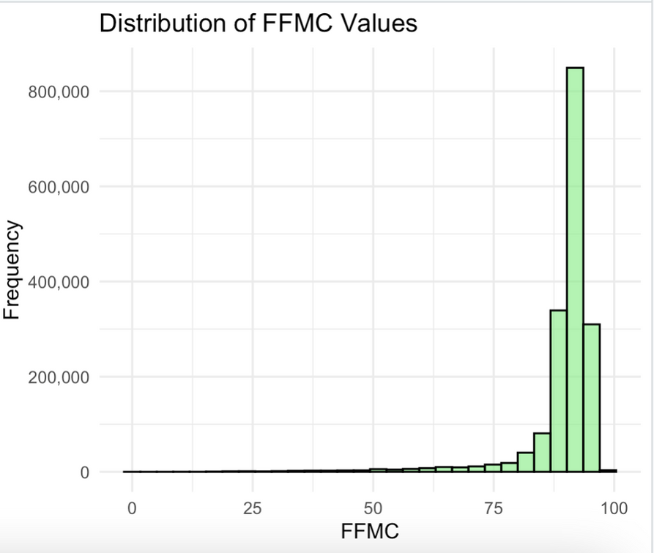
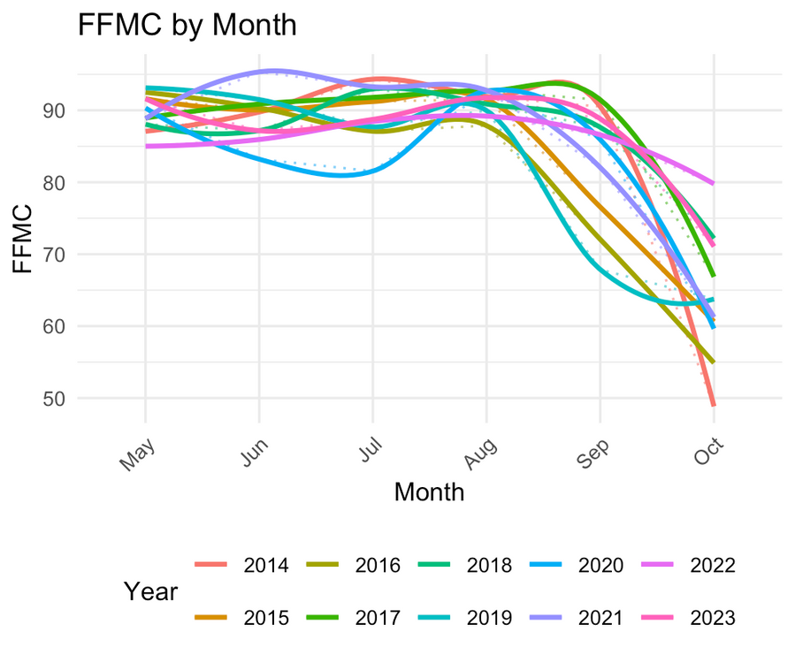
FIRE INDEX VARIABLE : FFMC, DMC, DC (MOISTURE CONTENT)
FFMC (Fine Fuel Moisture Code) - indicator of relatively ease of ignition & the flammability.
e.g small twigs, fallen leaves

Slide 14
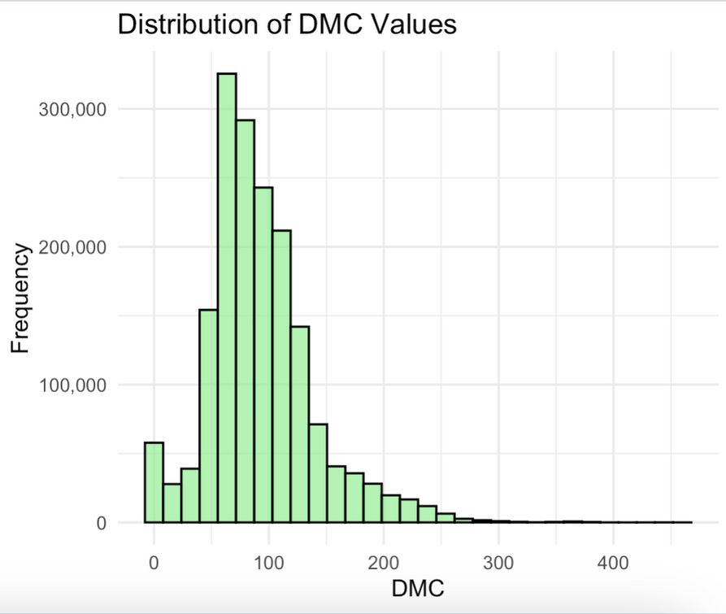
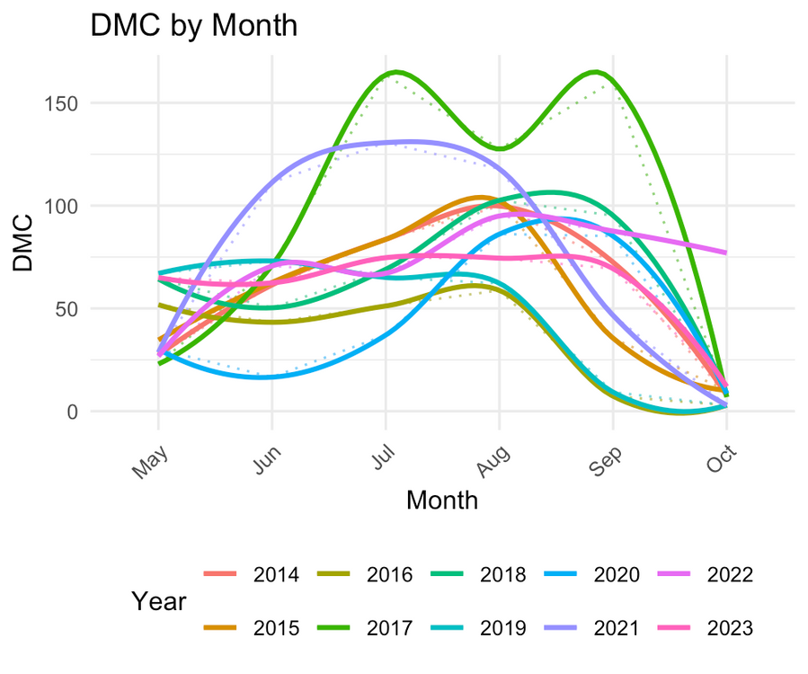
FIRE INDEX VARIABLE : FFMC, DMC, DC (MOISTURE CONTENT)
DMC (Duff Moisture Code) - average moisture content of loosely compacted organic layers of moderate depth.

Slide 15
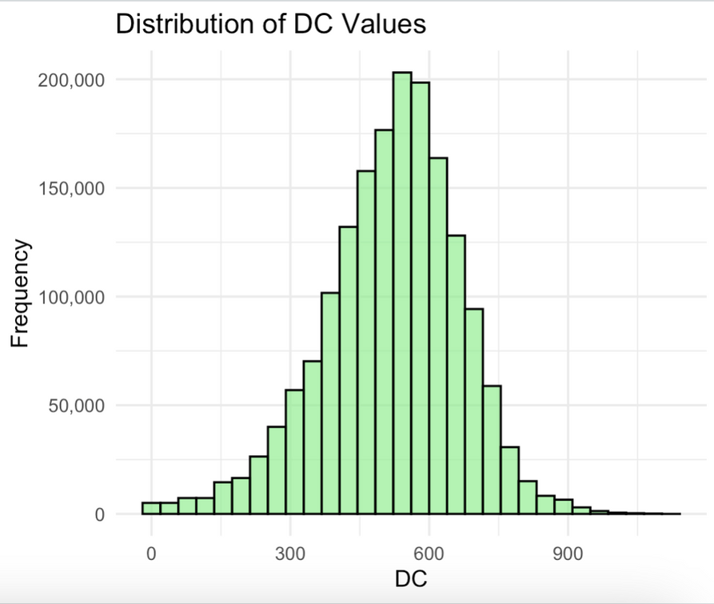
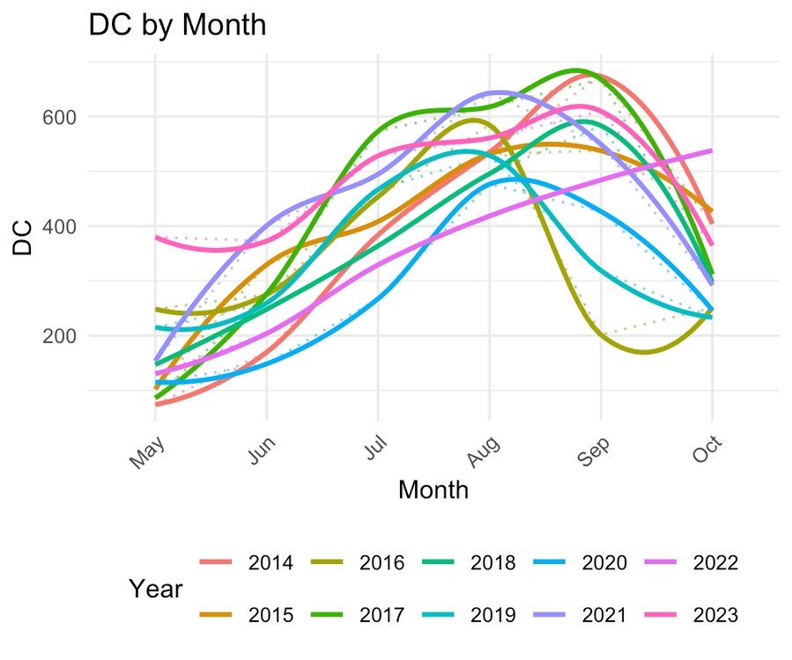
FIRE INDEX VARIABLE : FFMC, DMC, DC (MOISTURE CONTENT)
DC (Drought Code) - average moisture content of deep, compact organic layer

Slide 16
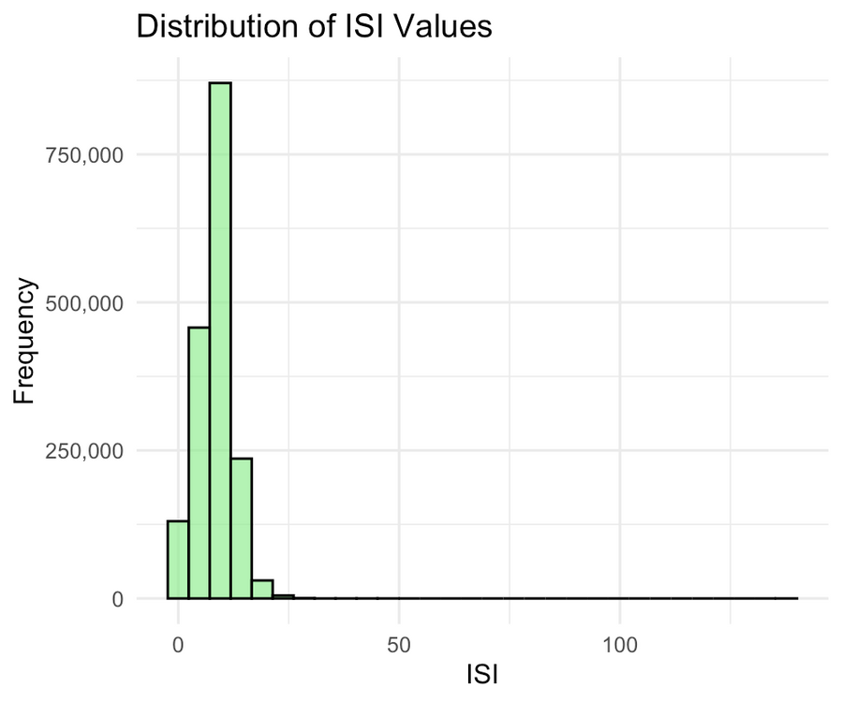
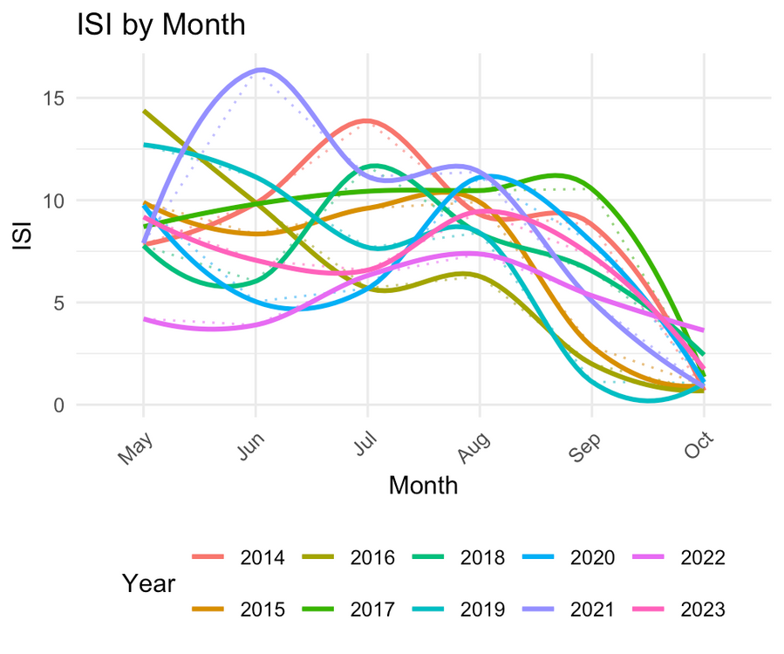
FIRE INDEX VARIABLE : ISI, BUI, FWI (FIRE BEHAVIOUR)
ISI (Initial Spread Index) - expected rate of fire spread

Slide 17
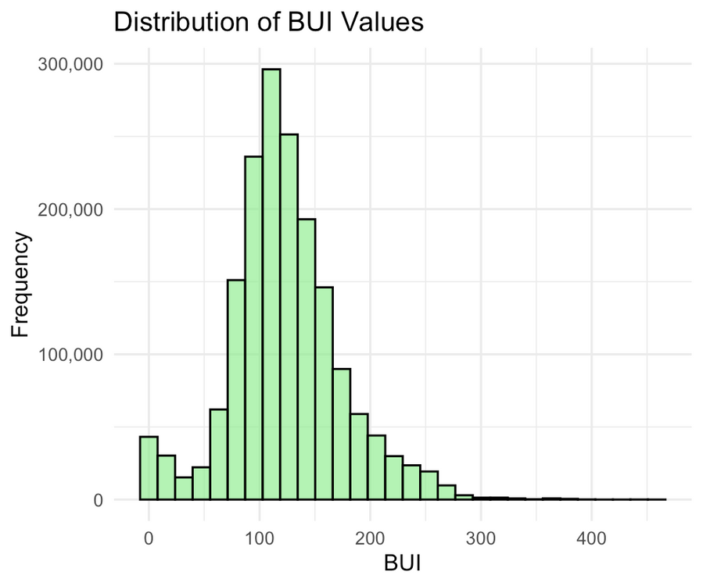
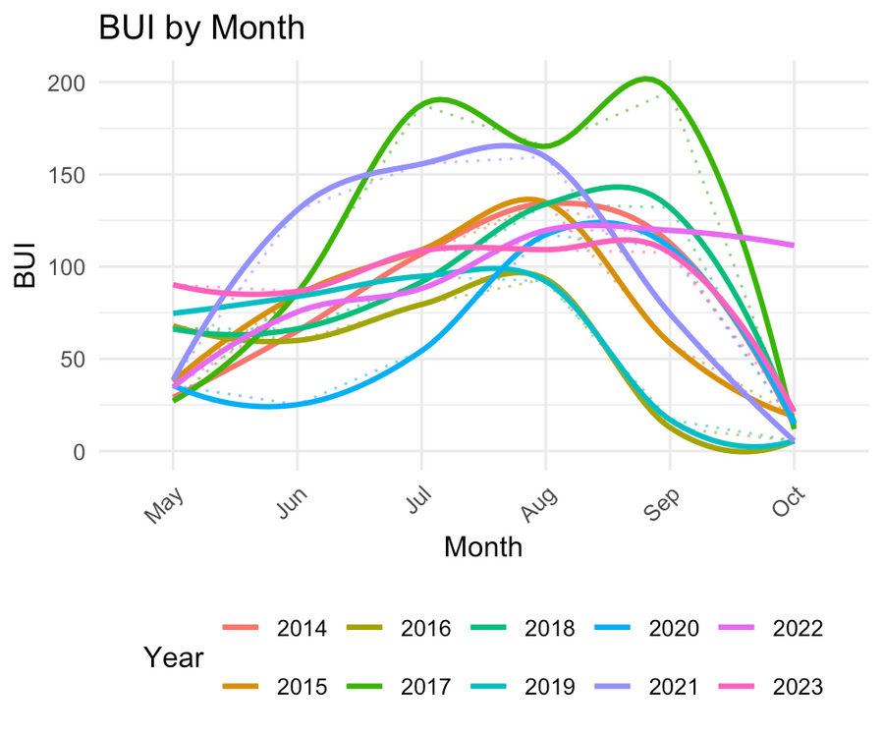
FIRE INDEX VARIABLE : ISI, BUI, FWI (FIRE BEHAVIOUR)
BUI (Buildup Index) - total amount of fuel available for combustion on the landscape

Slide 18
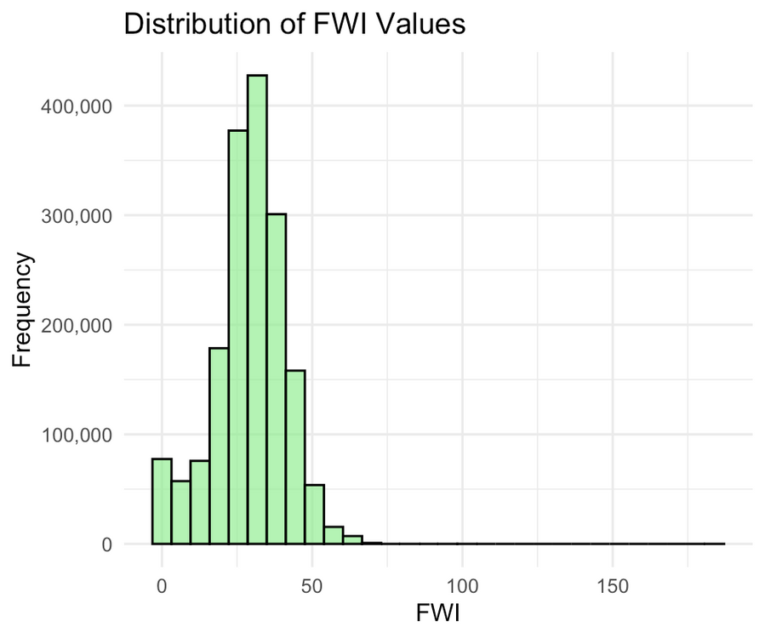
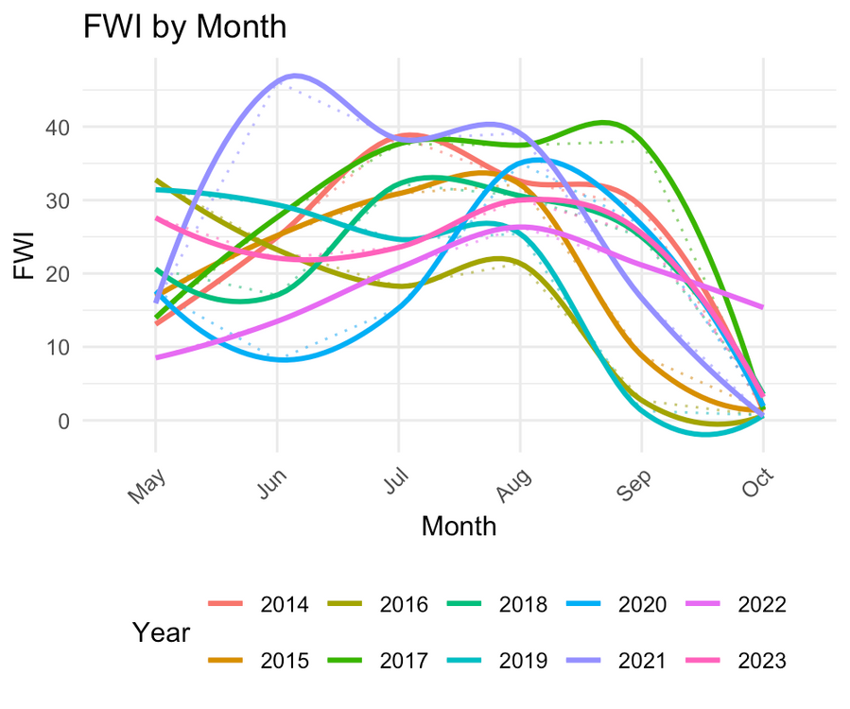
FIRE INDEX VARIABLE : ISI, BUI, FWI (FIRE BEHAVIOUR)
FWI (Fire Weather Index) - numeric rating of fire intensity

Slide 19

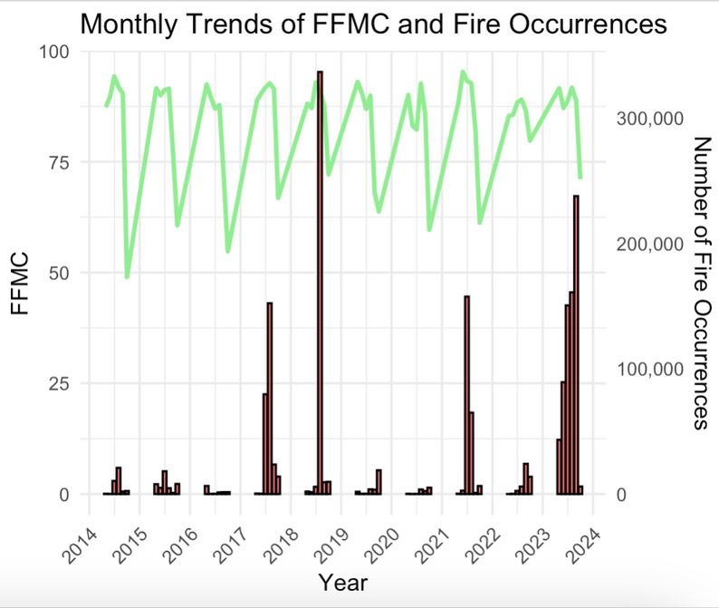
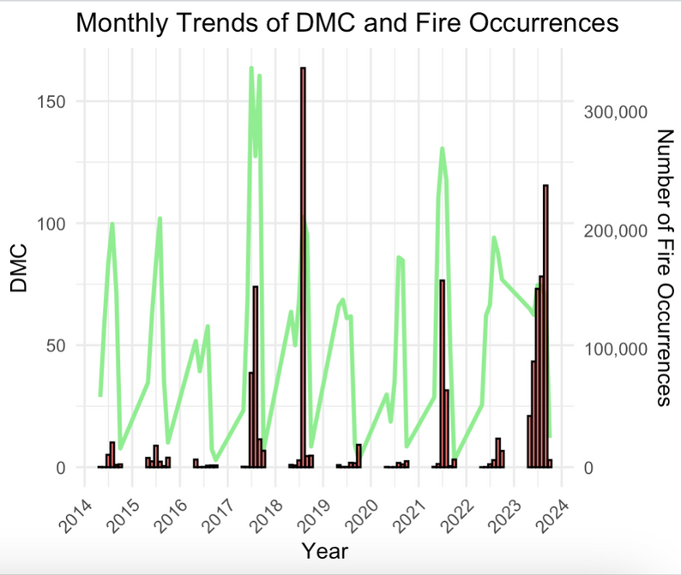
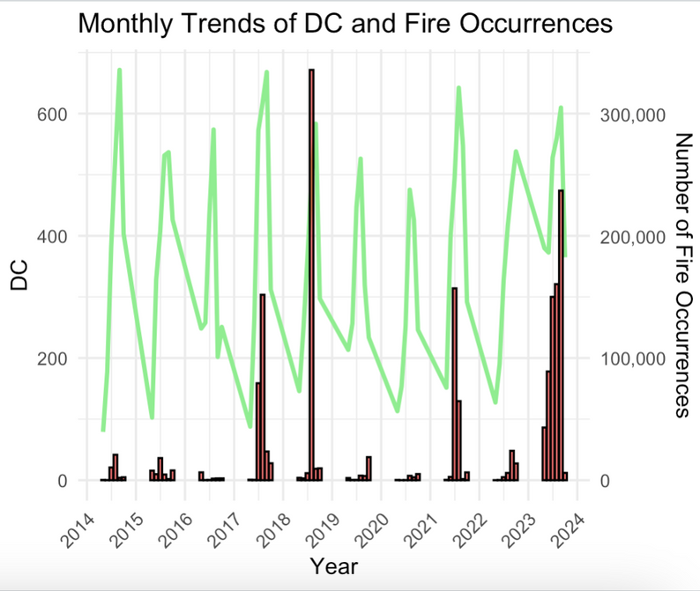
TREND ANALYSIS BETWEEN FIRE INDEX AND FIRE EVENTS

Slide 20
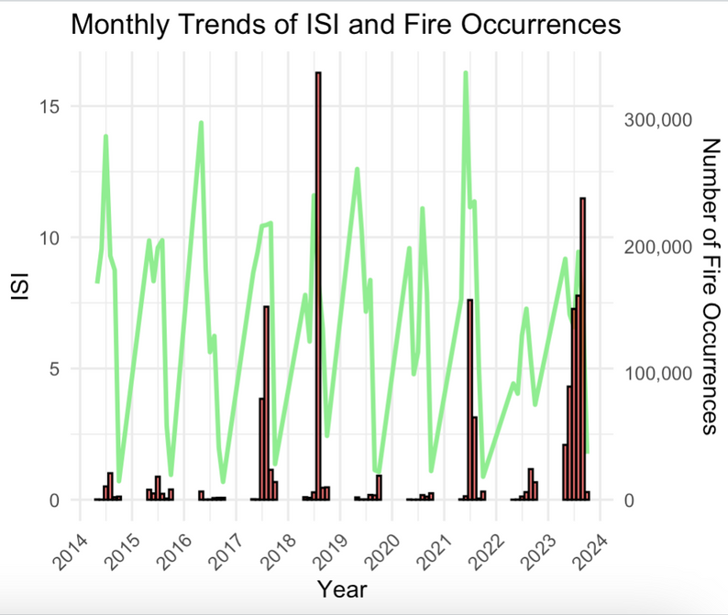
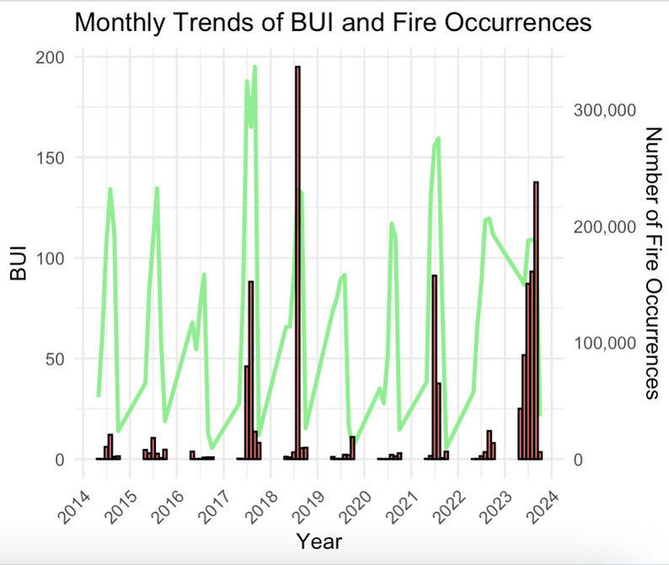
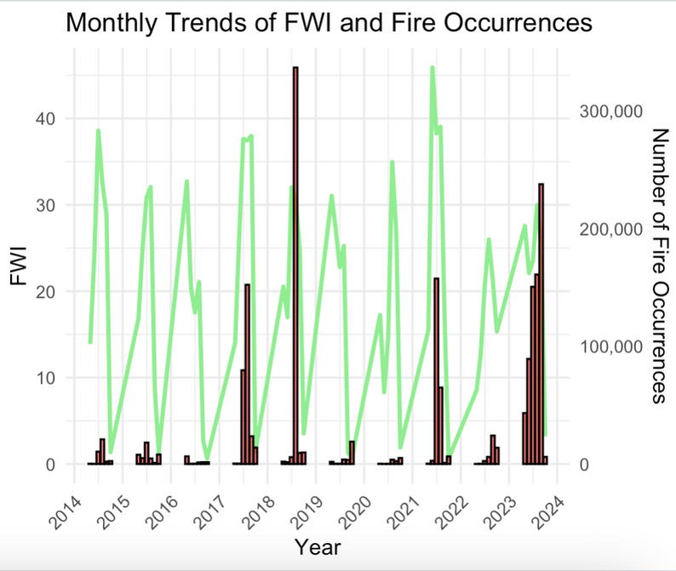
TREND ANALYSIS BETWEEN FIRE INDEX AND FIRE EVENTS

Slide 21
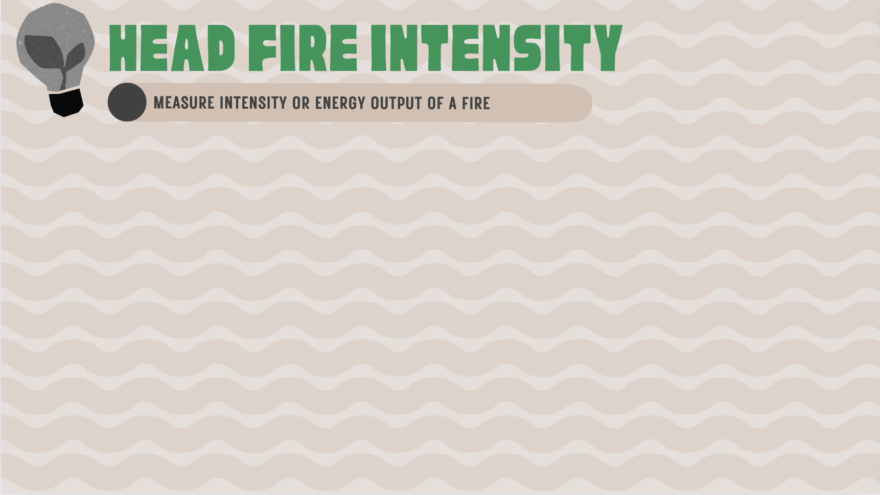
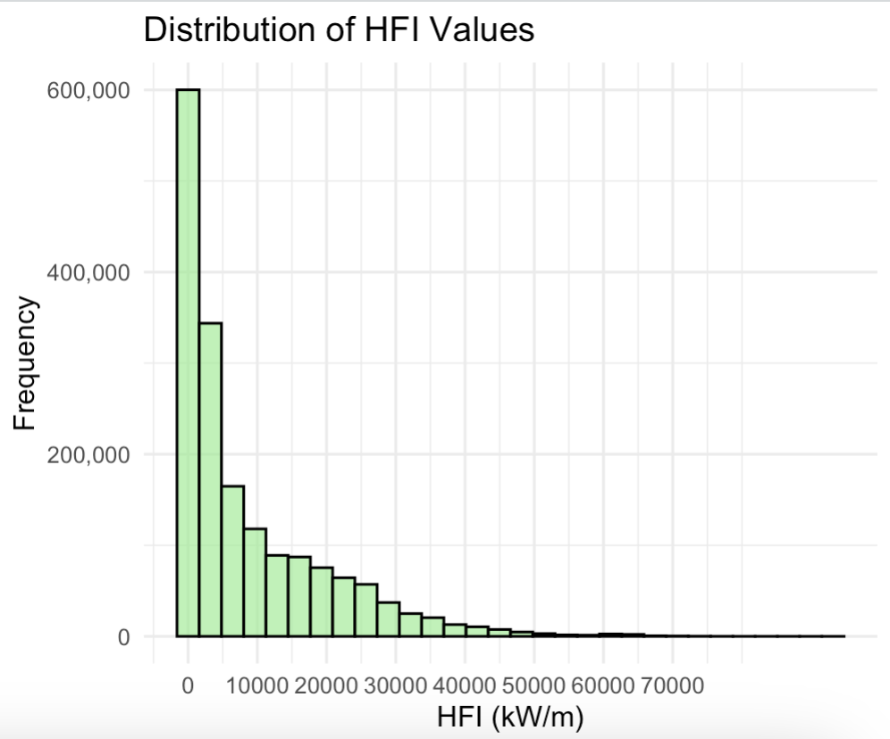
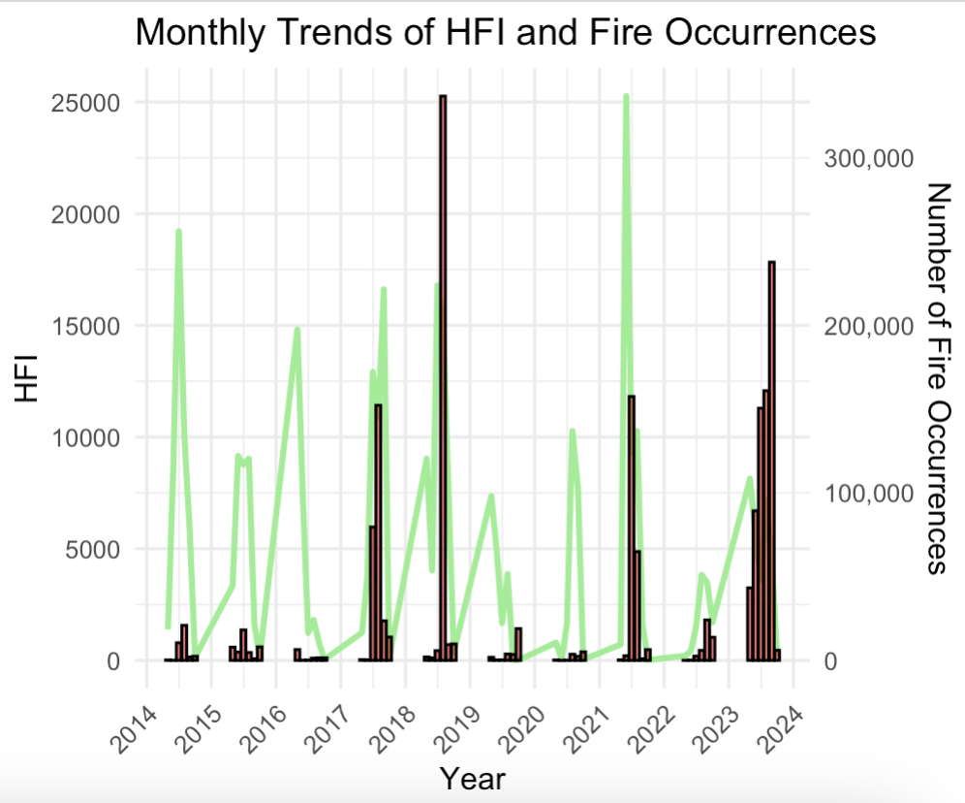
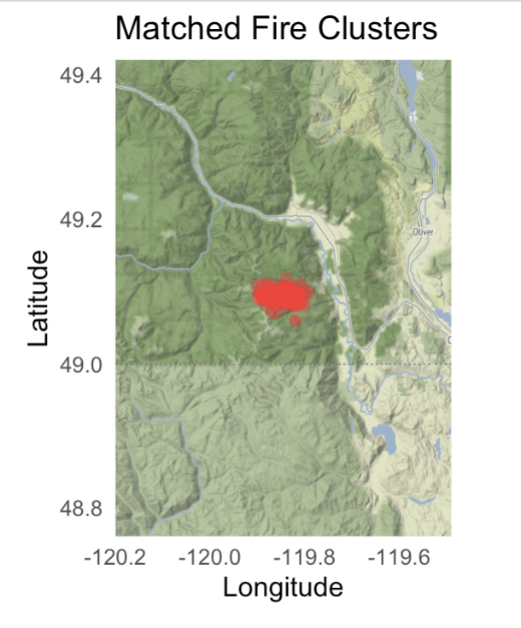
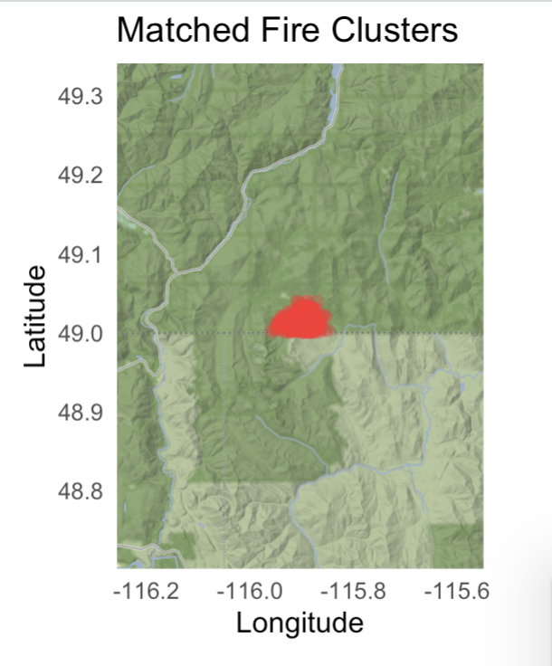
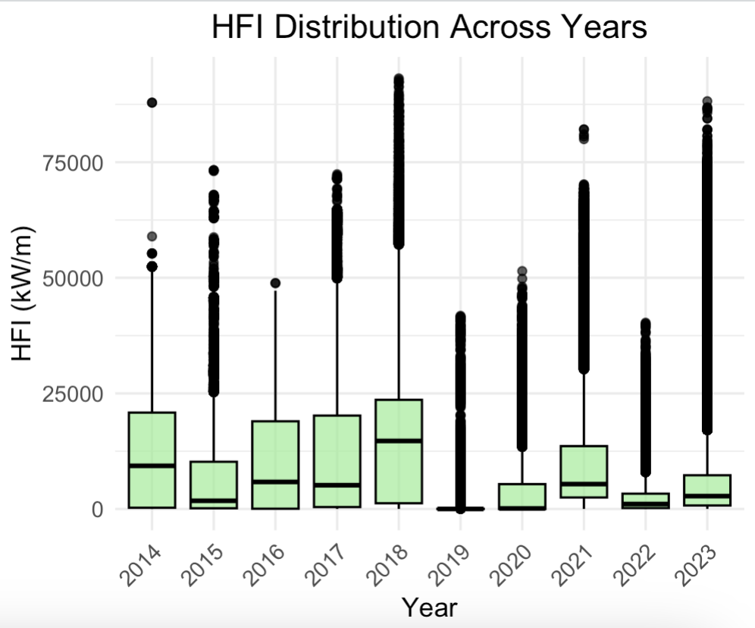
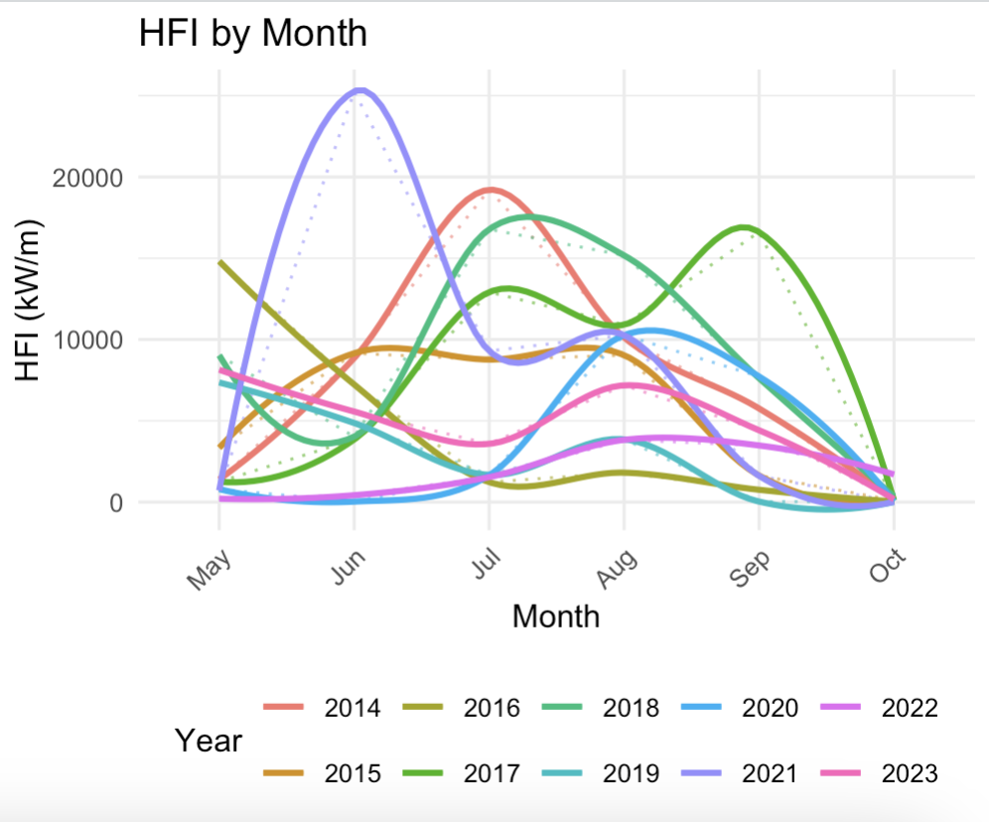
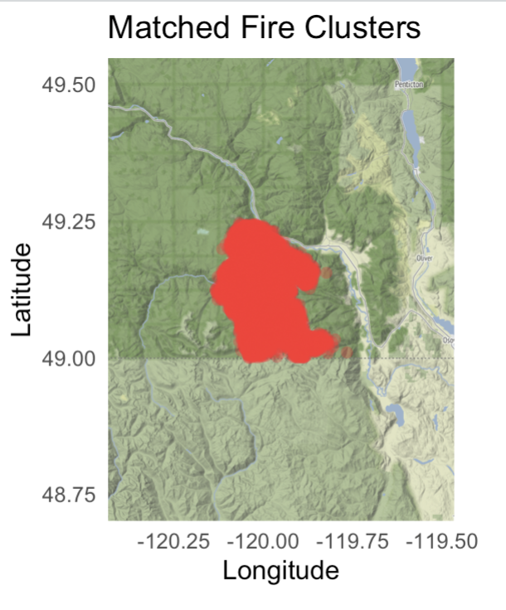
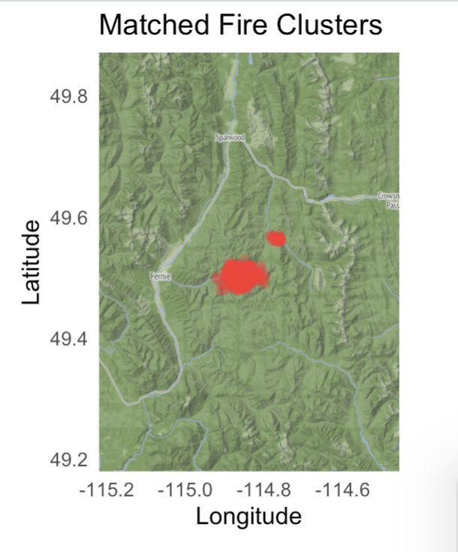
18 – 20 Jul 2018
11 – 15 Aug 2018
11 – 20 Aug 2023
11- 14 Aug 2018

Slide 22
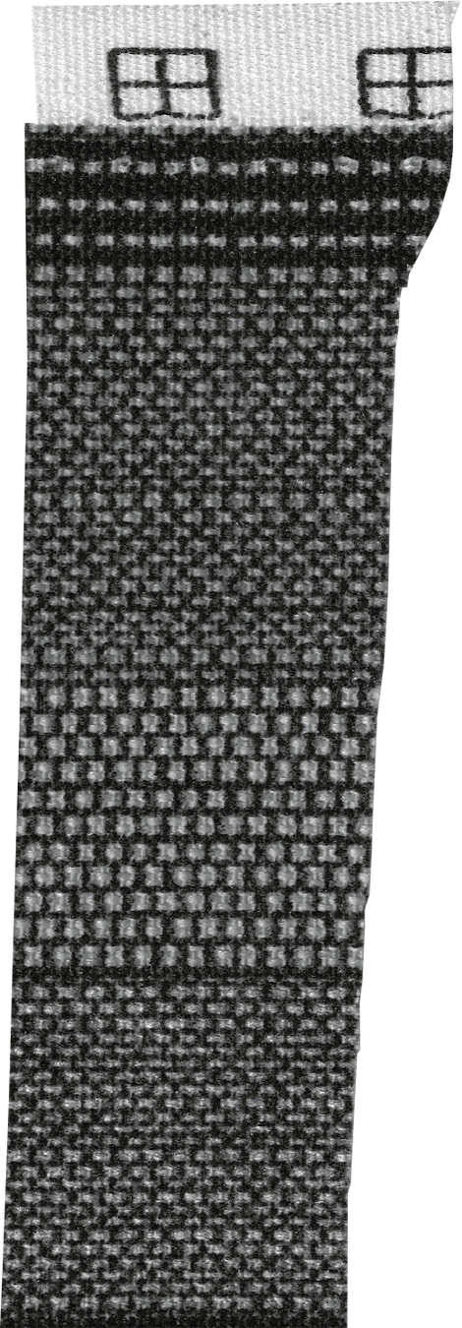
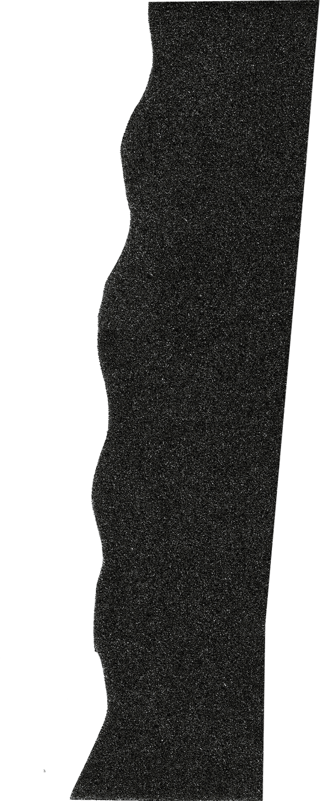

t-test and model
Subset to focus on numerical variables
Number of sample
Exclude outliers and check NA Value
Plot to see the normal distribution
Check correlations and choose predictors for linear regression model
Testing the Model
Run Appropriate T-test
Run Wilcoxon Test

Slide 23

testing procedure

Slide 24

testing procedure

Slide 25
testing procedure
Perform non-parametic test between data of 2018 vs overall data
Summary of overall years
Variable | Missing Value | Min | Median | Mean | Max
FFMC | 0 | 0.3 | 91.50 | 89.53 | 99.00
DMC | 0 | 0.0 | 85.20 | 92.60 | 459.78
DC | 0 | 0.0 | 531.77 | 518.81 | 1122.11
ISI | 0 | 0.0 | 8.62 | 8.50 | 137.70
BUI | 0 | 0.0 | 119.12 | 123.42 | 458.66
FWI | 0 | 0.0 | 30.09 | 29.13 | 183.90
Variable | P-value < 0.005
FFMC | TRUE
DMC | TRUE
DC | TRUE
ISI | TRUE
BUI | TRUE
FWI | TRUE
Summary of 2018
Variable | Missing Value | Min | Median | Mean | Max
FFMC | 0 | 11.38 | 91.27 | 90.07 | 99.00
DMC | 0 | 0.0 | 100.13 | 97.82 | 343.14
DC | 0 | 0.0 | 492.52 | 486.80 | 878.16
ISI | 0 | 0.0 | 8.22 | 7.90 | 24.81
BUI | 0 | 0.0 | 133.64 | 128.35 | 341.15
FWI | 0 | 0.0 | 30.72 | 28.83 | 57.93

Slide 26



testing procedure
Perform two-sample T-test for 2 cluster with similarity of fire index

Slide 27

linear regression

Slide 28





model
Transform number of fire event and fire index average in weekly basis
Normalised Distribution
using Boxcox

Slide 29
model
Model | Predictors | Adjusted R-Squared | Residual Std. Error | Significant Predictors | Multicollinearity (VIF > 10)
Model 1 | dmc, dc, bui, fwi, hfi, ffmc, isi | 0.4488 | 2.154 | dmc, dc, bui, fwi, hfi, isi | dmc (88.18), bui (155.39), fwi (58.12), isi (25.39)
Model 2 | dmc, dc, fwi, hfi, ffmc, isi | 0.4185 | 2.212 | dc, hfi, ffmc | fwi (49.44), isi (22.01)
Model 3 | dmc, dc, hfi, ffmc, isi | 0.4126 | 2.223 | dc, hfi, ffmc | None
Final | dc, hfi, ffmc | 0.4148 | 2.219 | dc, hfi, ffmc | None

Slide 30
model
Model 1
Model 2
Predictor | Slope of Line/Relationship | Avg. Distance of Points from Regression Line | Probability Slope is ≠ 0
dmc | 0.11 | 0.03 | 99.93%
dc | 0.01 | 0.002 | 99.99%
bui | -0.13 | 0.03 | 99.99%
fwi | 0.28 | 0.08 | 99.89%
hfi | 0.00021 | 0.00006 | 99.90%
ffmc | -0.004 | 0.024 | 12.31%
isi | -0.55 | 0.17 | 99.85%
Predictor | Slope of Line/Relationship | Avg. Distance of Points from Regression Line | Probability Slope is ≠ 0
dmc | -0.01 | 0.01 | 41.69%
dc | 0.01 | 0.001 | 99.98%
fwi | 0.15 | 0.08 | 94.19%
hfi | 0.00024 | 0.00006 | 99.98%
ffmc | -0.05 | 0.02 | 97.67%
isi | -0.31 | 0.16 | 93.88%
Model 3
Predictor | Slope of Line/Relationship | Avg. Distance of Points from Regression Line | Probability Slope is ≠ 0
dmc | 0.0063 | 0.0069 | 35.70%
dc | 0.0071 | 0.0012 | 99.94%
hfi | 0.00028 | 0.00006 | 99.95%
ffmc | -0.0413 | 0.021 | 95.20%
isi | -0.0351 | 0.08 | 33.90%

Slide 31



final model
Final Model
Predictor | Slope of Line/Relationship | Avg. Distance of Points from Regression Line | Probability Slope is ≠ 0
dc | 0.0079 | 0.00088 | 99.99%
hfi | 0.00028 | 0.000045 | 99.99%
ffmc | -0.04 | 0.013 | 99.73%

Slide 32
example
Hypothetical Conditions (Moderate, High, Extreme)
Condition Severity | Drought Code (dc) | Head Fire Intensity (hfi) | Fine Fuel Moisture Code (ffmc) | Predicted Number of Fires
Moderate | 200 | 1000 | 50 | 291
High | 400 | 7000 | 80 | 1768
Extreme | 600 | 12000 | 95 | 13140
Varying Head Fire Intensity
Drought Code (dc) | Head Fire Intensity (hfi) | Fine Fuel Moisture Code (ffmc) | Predicted Number of Fires
300 | 2000 | 70 | 368
300 | 4000 | 70 | 606
300 | 6000 | 70 | 993
300 | 8000 | 70 | 1618
300 | 10000 | 70 | 2625

Slide 33
example
Predicted Fires for Kelowna Clusters (Initial Model)
Cluster ID | Drought Code (dc) | Head Fire Intensity (hfi) | Fine Fuel Moisture Code (ffmc) | Duff Moisture Code (dmc) | Initial Spread Index (isi) | Buildup Index (bui) | Fire Weather Index (fwi) | Predicted Number of Fires
11964 | 865.94 | 3414.66 | 91.68 | 98.82 | 8.18 | 153.67 | 32.15 | 9105
11969 | 942.72 | 7212.46 | 93.91 | 179.39 | 16.01 | 243.03 | 52.64 | 9911
13047 | 889.23 | 3198.71 | 91.8 | 166.09 | 7.87 | 226.41 | 33.58 | 2774
13124 | 886.09 | 3788.14 | 92.06 | 166.92 | 7.94 | 226.93 | 33.82 | 3092
13384 | 894.19 | 1240 | 87.4 | 165.55 | 5.21 | 226.3 | 25.39 | 1012
13402 | 1017.1 | 146.25 | 82.97 | 187.43 | 2.69 | 256.6 | 15.87 | 264
13694 | 943.01 | 249.38 | 83.54 | 112.02 | 3.05 | 172.67 | 16.56 | 1409
Average |  |  |  |  |  |  |  | 3938
Predicted Fires for Kelowna Clusters (Final Model)
Cluster ID | Drought Code (dc) | Head Fire Intensity (hfi) | Fine Fuel Moisture Code (ffmc) | Predicted Number of Fires
11964 | 866.94 | 3414.66 | 91.68 | 11195
11969 | 942.72 | 7212.46 | 93.91 | 40926
13047 | 889.23 | 3198.71 | 91.8 | 12338
13124 | 886.09 | 3788.14 | 92.06 | 13749
13384 | 894.19 | 1240 | 87.4 | 9340
13402 | 1017.1 | 146.25 | 82.97 | 18643
13694 | 943.01 | 249.38 | 83.54 | 11593
Average |  |  |  | 16826

Slide 34

THANK YOU!

